Slide 1

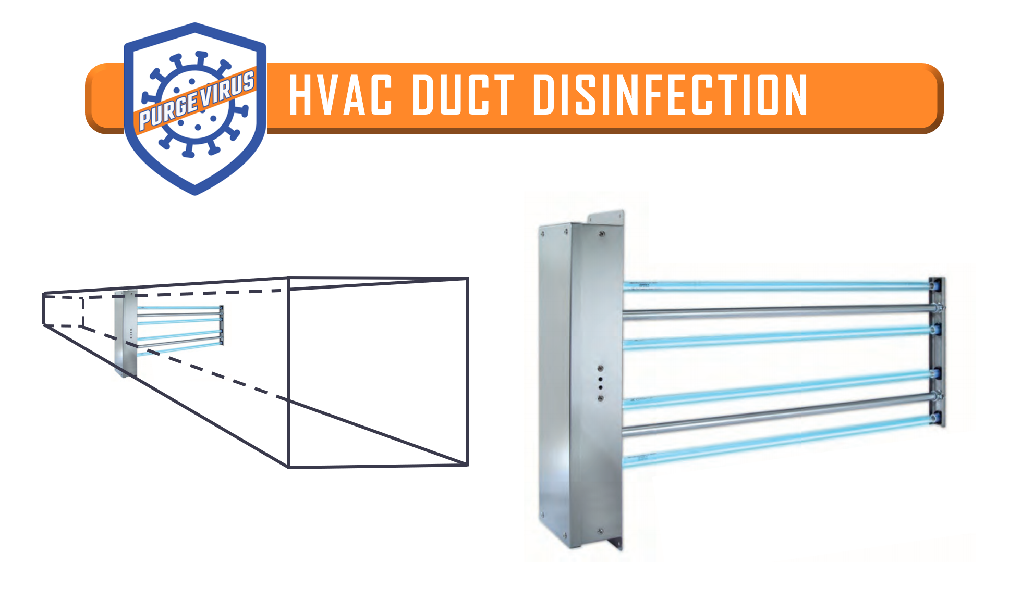
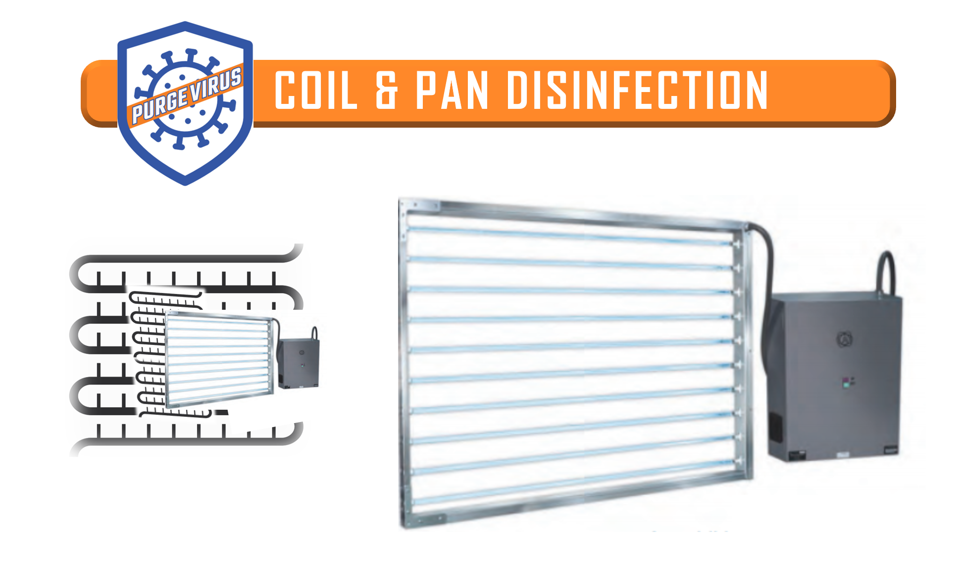
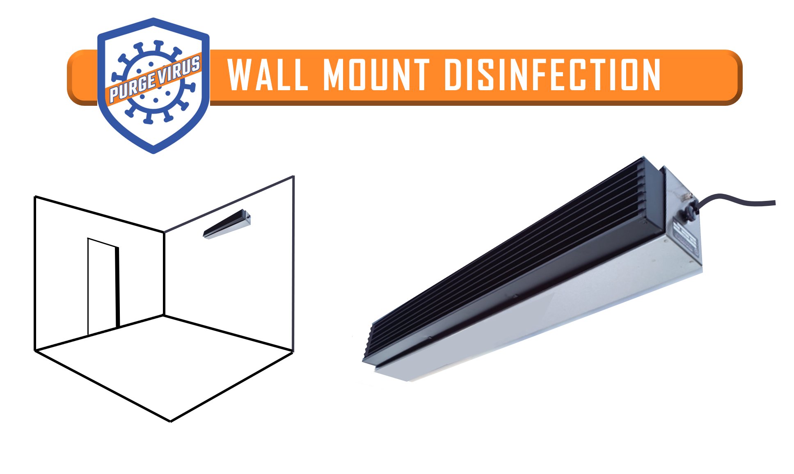
Sales Channel Partner /
Sales Rep Name
GERMICIDAL Ultraviolet (UV) LIGHT PRODUCT LINE
To reduce the spread of COVID-19 and reoccurring infections
WHICH SOLUTION IS BEST FOR MY FACILITY?
Ultraviolet light is a proven to sanitize airborne pathogens.
If you are considering a germicidal UV light system with duct and/or coil applications vs the in-room wall mounted devices, it is most beneficial to combine the HVAC Duct with the Coil & Pan devices, for maximum disinfection.
This approach provides intensive ultraviolet treatment with the added advantage of maintaining the performance of the coil and drain pan system for added longevity. The HVAC Duct devices can easily go anywhere in the ducts, while the Coil & Pan treatments typically need more planning for retrofits based on certain space confinements. Since the Wall Mount in-room devices can acutely treat vulnerable or high traffic rooms, such as healthcare waiting rooms, at quicker rates, consider a “Triple-Purge-Virus” approach.
All of the solutions have similar overall results reducing airborne contaminants by over 99 percent, depending on the microbes.
CONTACT:
Company Name:
Contact Name:
Email:
Tel:
Address:
NEXT STEP: Please see the information on each system on the following pages and fill out the Data Sheet (also available in a separate excel file) with information on your current ducts and or room sizes for the wall mounted solution. We will get back to you with a proposal for your facility.
Supply/Manufacturing Partner
www.PurgeVirus.com

Slide 2
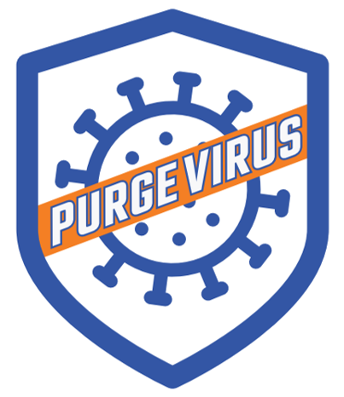

Slide 3
www.PurgeVirus.com

Slide 4
www.PurgeVirus.com

Slide 5
www.PurgeVirus.com

